Slide 1
MAD
Mean Absolute Deviation
Objective
Find and interpret the mean absolute deviation for a set of data.

Slide 2
Mean Absolute Deviation
The average distance between each data value and the mean.

Slide 3
Measures of Center
Mean and Median
Measures of Variability
Range and MAD

Slide 4
Mean Absolute Deviation
The bigger (>) the MAD the more variation.
The smaller (<) the MAD the less variation.

Slide 5
Steps
1. Find the mean.
2. Find the distance between data and the mean.
3. Find the average of the differences
[Subtract the mean from each value - the result is called the deviation from the mean]

Slide 6
Find the Mean
Number of cell phone contacts
stored in 8 friends phones :
52, 48, 60, 55, 59, 54, 58, 62
Find the mean:
52+48+60+55+59+54+58+62=56
8

Slide 7
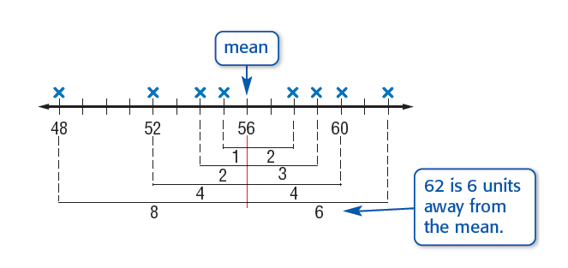
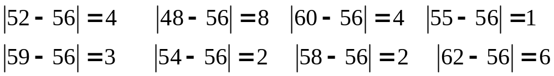
Find the Mean Absolute Deviation
Find the deviation from the mean

Slide 8
Find the mean absolute deviation
Number of cell phone contacts stored in 8 friends phones :
52, 48, 60, 55, 59, 54, 58, 62
Find the sum of the absolute values:
8 + 4 + 2 + 1 + 2 + 3 + 4 + 6 = 30
Divide the sum by the number of data items:
30 = 3.75
8

Slide 9
Find the mean absolute deviation
Number of cell phone contacts stored in 8 friends phones :
52, 48, 60, 55, 59, 54, 58, 62
This means the average distance between each data value and the mean is 3.75 contacts.

Slide 10
Find the Mean
Roller coaster speeds for 8 roller
coasters were:
58, 88, 40, 60, 72, 66, 80 & 48
Find the mean:
58+88+40+60+72+66+80+48=64
8

Slide 11
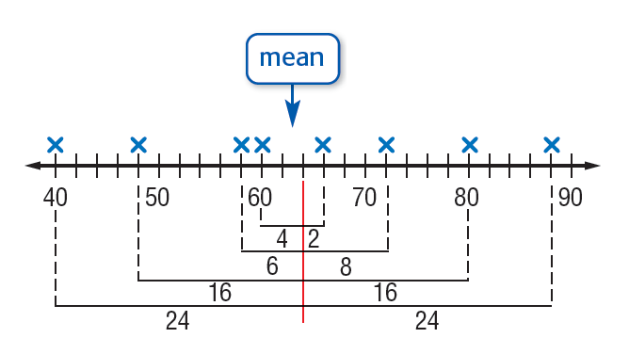
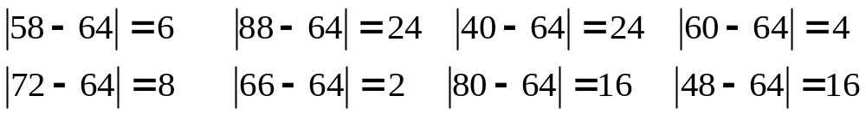
Find the Mean Absolute Deviation
Find the deviation from the mean

Slide 12
Find the mean absolute deviation
Roller coaster speeds were:
58, 88, 40, 60, 72, 66, 80, 48
Find the sum of the absolute values:
6 + 24 + 24 + 4 + 8 + 2 + 16 + 16 = 100
Divide the sum by the number of data items:
100 = 12.5
8

Slide 13
Find the mean absolute deviation
Roller coaster speeds were:
58, 88, 40, 60, 72, 66, 80, 48
This means the average distance each data value is from the mean is 12.5 miles per hour.

Slide 14
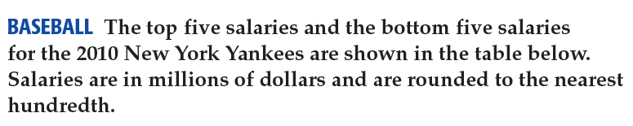
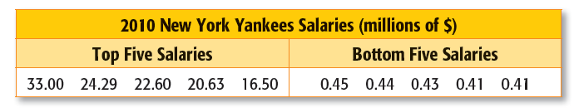

Slide 15
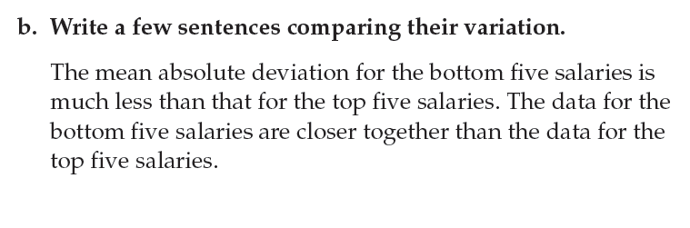

Slide 16
TRY THESE

Slide 17
Find the mean absolute deviation
Test scores for 6 students were :
85, 92, 88, 80, 91 and 74.
Find the mean:
(85+92+88+80+91+74)/6=85
2. Find the deviation from the mean:
85-85=0 92-85=7 88-85=3
80-85=-5 91-85=6 74-85=-11

Slide 18
Find the mean absolute deviation
Test scores for 6 students were :
85, 92, 88, 80, 91 and 74.
3. Find the absolute value of each deviation from the mean:

Slide 19
Find the mean absolute deviation
Test scores for 6 students were :
85, 92, 88, 80, 91 and 74.
4. Find the sum of the absolute values:
0 + 7 + 3 + 5 + 6 + 11 = 32
5. Divide the sum by the number of
data items:
32/6 = 5.3
The mean absolute deviation is 5.3.

